Slide 1
Advanced Data Mining
Naïve Bayes and C5.0

Slide 2
ADM so far
We’ve covered:
Intro to data mining: types of problems + core methodologies: KDD + CRISP-DM
Built classification models from scratch making simple assumptions (e.g. all women survive)
Looked how to evaluate the performance of classifiers :
Holdout
Cross fold validation (see solutions to lab 2)
Built 2 of the core go to supervised models (ones that tend to always do reasonably well) and evaluated them:
kNN, and
Logistic regression
Today we add 2 more go to supervised models (see moodle for a slower more gentle overview)
Naïve Bayes
The C5.0 tree

Slide 3
Source for slides
Lantz, B. (2013), Machine Learning with R (1st Edition). Packt Publishing: Chap 4 (Naïve Bayes) + Chap 5 (C5.0 Decision Tree)
Both of these chapters go into other models that are also useful to look into, they also provide additional examples.

Slide 4
Introducing Naïve Bayes
Naïve because it makes simple assumptions about the data and feature dependencies
It’s a probabilistic model, using estimates concerned with describing uncertainty, i.e. it utilizes training data to calculate an observed probability of each class based on feature values.
Bayesian classifiers have been used for:
Text classification, such as junk email (spam) filtering, author identification, or topic categorization
Intrusion detection or anomaly detection in computer networks
Diagnosing medical conditions, when given a set of observed symptoms
Note that Naïve Bayes can struggle with classification problems where there are a large number of class labels, or where class labels are somewhat arbitrary, e.g. a 69% H2-1 is not that different to a 70% H1-1

Slide 5
Probability
Classifiers based on Bayesian methods utilize training data to calculate an observed probability of each class based on feature values.
When the classifier is used later on unlabeled data, it uses the observed probabilities to predict the most likely class for the new features.
It's a simple idea, but it results in a method that often has results on par with more sophisticated algorithms.
In fact, Bayesian classifiers have been used for:
Text classification, such as junk email (spam) filtering, author identification, or topic categorization
Intrusion detection or anomaly detection in computer networks
Diagnosing medical conditions, when given a set of observed symptoms

Slide 6
Introduction
Typically, Bayesian classifiers are best applied to problems in which the information from numerous attributes should be considered simultaneously in order to estimate the probability of an outcome.
While many algorithms ignore features that have weak effects, Bayesian methods utilize all available evidence to subtly change the predictions.
If a large number of features have relatively minor effects, taken together their combined impact could be quite large.
Bayesian probability theory is rooted in the idea that the estimated likelihood of an event should be based on the evidence at hand.
Events are possible outcomes, such as sunny and rainy weather, a heads or tails result in a coin flip, or spam and not spam email messages.
A trial is a single opportunity for the event to occur, such as a day's weather, a coin flip, or an email message.

Slide 7
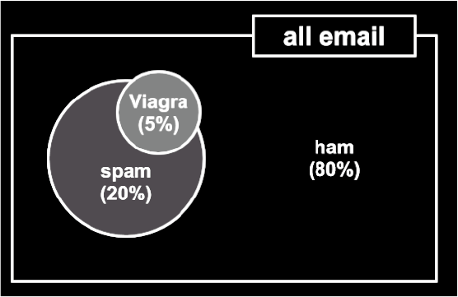
Joint Probability
Often, we are interested in monitoring several non-mutually exclusive events for the same trial. If some events occur with the event of interest, we may be able to use them to make predictions.
Consider, for instance, a second event based on the outcome that the email message contains the word Viagra.
For most people, this word is only likely to appear in a spam message; its presence in a message is therefore a very strong piece of evidence that the email is spam.
The Viagra circle does not completely fill the spam circle, nor is it completely contained by the spam circle. This implies that not all spam
messages contain the word Viagra, and not every email with the word Viagra is spam.
For our titanic dataset, we also have a wide range of somewhat non-mutually exclusive events: e.g. Gender / Title vs. Survival

Slide 8
Joint Probability
We know:
that some % of all messages were spam and some other % of all messages contained Viagra.
38% of people survived the titanic, and that 26% of people were female and survived.
Our job is to quantify the degree of overlap between these two proportions.
In other words, estimate the probability of both occurring, i.e.
P(spam ∩ Viagra)
P(survived ∩ female)
…
P(Y ∩ X_{i})
Calculating P(Y ∩ X_{i}) depends on the joint probability of the two events, or how the probability of one event is related to the probability of the other.
If the two events are totally unrelated, they are called independent events.
For instance, the outcome of a coin flip is independent from whether the weather is rainy or sunny.
If all events were independent, it would be impossible to predict any event using the data obtained by another. On the other hand, dependent events are the basis of predictive modeling.

Slide 9
Joint Probability – Independence
If we assume that P(spam) and P(Viagra) were independent, we could then easily calculate P(spam ∩ Viagra); the probability of both events happening at the same time.
(Note that they are not independent however!)
Because 20 percent of all messages are spam, and 5 percent of all emails contain the word Viagra, we could assume that 5 percent of 20 percent (0.05 * 0.20 = 0.01), or 1 percent of all messages are spam containing the word Viagra.
More generally, for independent events A and B, the probability of both happening is P(A ∩ B) = P(A) * P(B).
In reality, it is far more likely that P(spam) and P(Viagra) are highly dependent, which means that this calculation is incorrect. So we need…

Slide 10
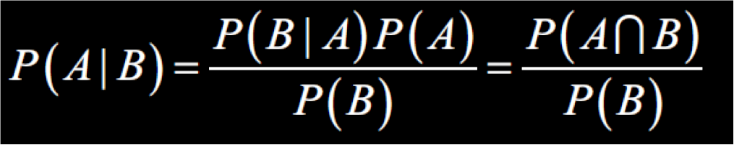
Conditional Probability
The relationships between dependent events can be described using Bayes‘ Theorem, as shown in the following formula.
The notation P(A|B) can be read as the probability of event A given that event B occurred.
This is known as conditional probability, since the probability of A is dependent (that is, conditional) on what happened with event B.

Slide 11
Probability – Example
Suppose that you were tasked with guessing the probability that an incoming email was spam.
Without any additional evidence, the most reasonable guess would be the probability that any prior message was spam (that is, 20 percent in the preceding example).
This estimate is known as the prior probability.
Now, also suppose that you obtained an additional piece of evidence; you were told that the incoming message used the term Viagra.
The probability that the word Viagra was used in previous spam messages is called the likelihood and the probability that Viagra appeared in any message at all is known as the marginal likelihood

Slide 12
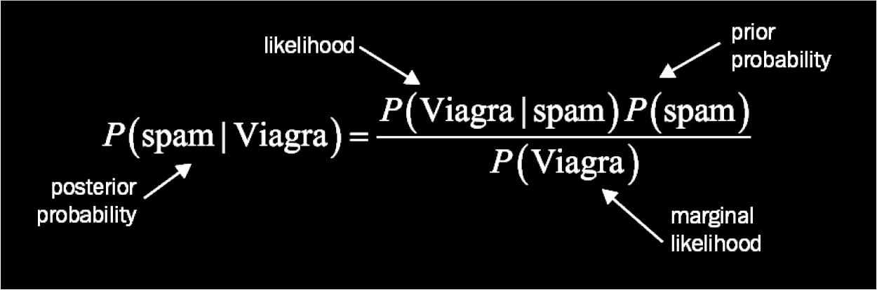
Probability – Example
By applying Bayes' theorem to this evidence, we can compute a posterior probability that measures how likely the message is to be spam.
If the posterior probability is greater than 50 percent, the message is more likely to be spam than ham, and it can potentially be filtered.
The following formula is the Bayes' theorem for the given evidence:

Slide 13
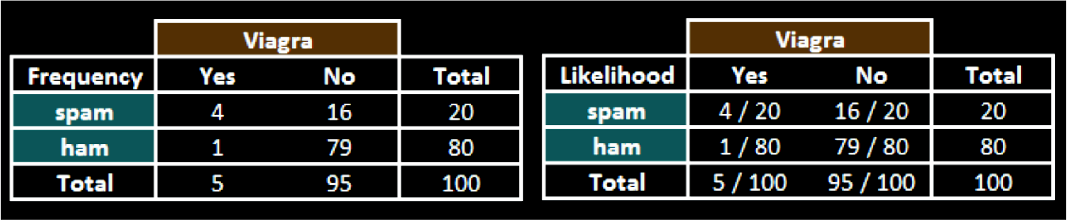
Probability – Example
Of course we need information on how frequently has occurred as spam or ham.
Lets assume these numbers:
The likelihood table reveals that P(Viagra|spam) = 4/20 = 0.20, indicating that the probability is 20 percent that a spam message contains the term Viagra.
Additionally, since the theorem says that P(B|A) * P(A) = P(A ∩ B), we can calculate P(spam ∩ Viagra) as P(Viagra|spam) * P(spam) = (4/20) * (20/100) = 0.04.
This is four times greater than the previous estimate under the faulty independence assumption

Slide 14
Probability – Example
We aren’t finished yet!
To compute the posterior probability, P(spam|Viagra), we simply take P(Viagra|spam) * P(spam) / P(Viagra), or (4/20) * (20/100) / (5/100) = 0.80.
Therefore, the probability is 80 percent that a message is spam, given that it contains the word Viagra.
Therefore, any message containing this term should be filtered.
This is very much how commercial spam filters work, although they consider a much larger number of words simultaneously when computing the frequency and likelihood tables.

Slide 15
Naïve Bayes
The naive Bayes algorithm is named as such because it makes a couple of "naive“ assumptions about the data.
In particular, naive Bayes assumes that all of the features in the dataset are equally important and independent.
These assumptions are rarely true in most of the real-world applications.
However, in most cases when these assumptions are violated, naive Bayes still performs fairly well.
This is true even in extreme circumstances where strong dependencies are found among the features. Due to the algorithm's versatility and accuracy across many types of conditions, naive Bayes is often a strong first candidate for classification learning tasks.
Why? …if a spam filter correctly identifies spam, does it matter that it was 51 percent or 99 percent confident in its prediction?
However, don’t forget our discussion on conservative vs. liberal classification (see Lab 2 Task 2, where we shifted our confidence thresholds!)

Slide 16
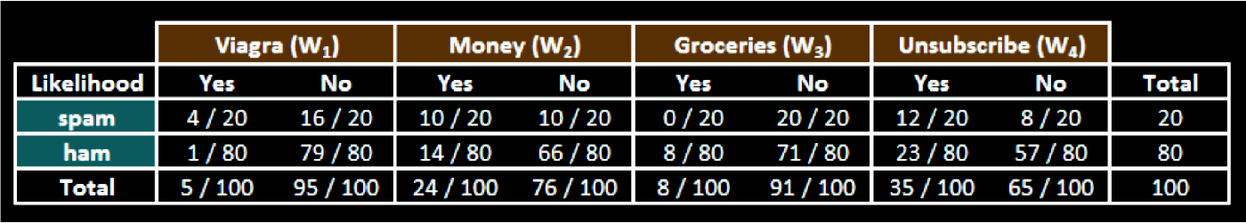
Naïve Bayes – Example
Let's extend our spam filter by adding a few additional terms to be monitored: money, groceries, and unsubscribe.
The naive Bayes learner is trained by constructing a likelihood table for the appearance of these four words (W1, W2, W3, and W4), as shown in the following diagram for 100 emails:
As new messages are received, the posterior probability must be calculated to determine whether they are more likely spam or ham, given the likelihood of the words found in the message text.
For example, suppose that a message contains the terms Viagra and Unsubscribe, but does not contain either Money or Groceries.

Slide 17
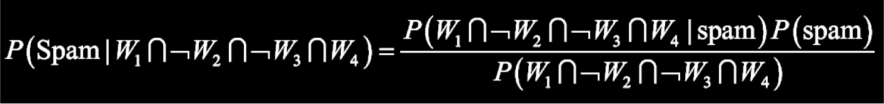
Naïve Bayes – Example
Using Bayes' theorem, we can define the problem as shown in the following formula, which captures the probability that a message is spam, given that Viagra = Yes, Money = No, Groceries = No, and Unsubscribe = Yes:
For a number of reasons, this formula is computationally difficult to solve. As additional features are added, tremendous amounts of memory are needed to store probabilities for all of the possible intersecting events; imagine the complexity of a Venn diagram for the events for four words, let alone for hundreds or more…

Slide 18
Naïve Bayes - Class-Conditional Independence
The work becomes much easier if we can exploit the fact that naive Bayes assumes independence among events.
Specifically, naive Bayes assumes class-conditional independence, which means that events are independent so long as they are conditioned on the same class value.
Assuming conditional independence allows us to simplify the formula using the probability rule for independent events, which you may recall is P(A ∩ B) = P(A) * P(B). This results in a much easier-to-compute formulation, shown as follows:

Slide 19
Naïve Bayes – Example
Using the values in the likelihood table, we can start filling numbers in these equations. Because the denominator is the same in both cases, it can be ignored for now. The overall likelihood of spam is then:
(4/20) * (10/20) * (20/20) * (12/20) * (20/100) = 0.012
While the likelihood of ham given this pattern of words is:
(1/80) * (66/80) * (71/80) * (23/80) * (80/100) = 0.002
Because 0.012 / 0.002 = 6, we can say that this message is six times more likely to be spam than ham.
However, to convert these numbers to probabilities, we need one last step.
The probability of spam is equal to the likelihood that the message is spam divided by the likelihood that the message is either spam or ham:
0.012 / (0.012 + 0.002) = 0.857

Slide 20
Naïve Bayes – Problems
Suppose we received another message, this time containing the terms: Viagra, Groceries, Money, and Unsubscribe. The likelihood of spam is:
(4/20) * (10/20) * (0/20) * (12/20) * (20/100) = 0
Surely this is a misclassification? Right?
This problem might arise if an event never occurs for one or more levels of the class.
For instance, the term Groceries had never previously appeared in a spam message.
Consequently, P(spam|groceries) = 0%.
Because probabilities in naive Bayes are multiplied, this 0 percent value causes the posterior probability of spam to be zero, giving the word Groceries the ability to effectively nullify and overrule all of the other evidence.
Even if the email was otherwise overwhelmingly expected to be spam, the absence of the word Groceries will always result in a probability of spam being zero.

Slide 21
Naïve Bayes - Laplace Estimator
A solution to this problem involves using something called the Laplace estimator, which is named after the French mathematician Pierre-Simon Laplace.
The Laplace estimator essentially adds a small number to each of the counts in the frequency table, which ensures that each feature has a nonzero probability of occurring with each class.
Typically, the Laplace estimator is set to 1, which ensures that each class-feature combination is found in the data at least once.
The Laplace estimator can be set to any value, and does not necessarily even have to be the same for each of the features.

Slide 22
Naïve Bayes – Laplace Estimator
Using a Laplace value of 1, we add one to each numerator in the likelihood function. The total number of 1s must also be added to each denominator.
The likelihood of spam is therefore:
(5/24) * (11/24) * (1/24) * (13/24) * (20/100) = 0.0004
And the likelihood of ham is:
(2/84) * (15/84) * (9/84) * (24/84) * (80/100) = 0.0001
This means that the probability of spam is 80 percent and the probability of ham is 20 percent; a more plausible result than the one obtained when Groceries alone determined the result.

Slide 23
Naïve Bayes – Numeric Features
Because naive Bayes uses frequency tables for learning the data, each feature must be categorical in order to create the combinations of class and feature values comprising the matrix.
Since numeric features do not have categories of values, the preceding algorithm does not work directly with numeric data.
One easy and effective solution is to discretize numeric features, which simply means that the numbers are put into categories known as bins.
For this reason, discretization is also sometimes called binning.
This method is ideal when there are large amounts of training data, a common condition when working with Naïve Bayes.

Slide 24
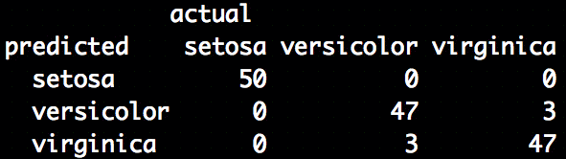
Example – in R (granted only on training data and using Iris!)
> data(iris)
> pairs(iris[1:4],main="Iris Data (red=setosa,green=versicolor,blue=virginica)", pch=21, bg=c("red","green3","blue")[unclass(iris$Species)])
> library(e1071)
> classifier<-naiveBayes(iris[,1:4], iris[,5])
> table(predict(classifier, iris[,-5]), iris[,5], dnn=list('predicted','actual'))
Notes:
Taken from: http://www-users.cs.york.ac.uk/~jc/teaching/arin/R_practical/

Slide 25
Summary
Naïve Bayes is:
Really easy to implement and often works well
Often a good first thing to try
Commonly used as a “punching bag” for smarter algorithms.
See Moodle for a basics example that adds to the titantic example of Lab 3:
A text analytics study that exemplifies the reason why Naïve Bayes is the standard for text classification: directly out of the box, it performs surprisingly well.

Slide 26
Naïve Bayes Strengths and Weaknesses
Strengths | Weaknesses
Simple, fast, and very effective | Relies on an often-faulty assumption of equally important and independent features
Does well with noisy and missing data | Not ideal for datasets with large numbers of numeric features
Requires relatively few examples for training, but also works well with very large numbers of examples | Estimated probabilities are less reliable than the predicted classes
Easy to obtain the estimated probability for a prediction

Slide 27
Introduction To Decision Trees
Decision trees:
a machine learning method that applies a strategy of dividing data into smaller and smaller portions to identify patterns that can be used for prediction.
Knowledge is presented in the form of logical structures that can be understood without any statistical knowledge.
This aspect makes these models particularly useful for business strategy and process improvement.
They have a high explanatory power.
We can derive rules from the different traversals of the tree.

Slide 28
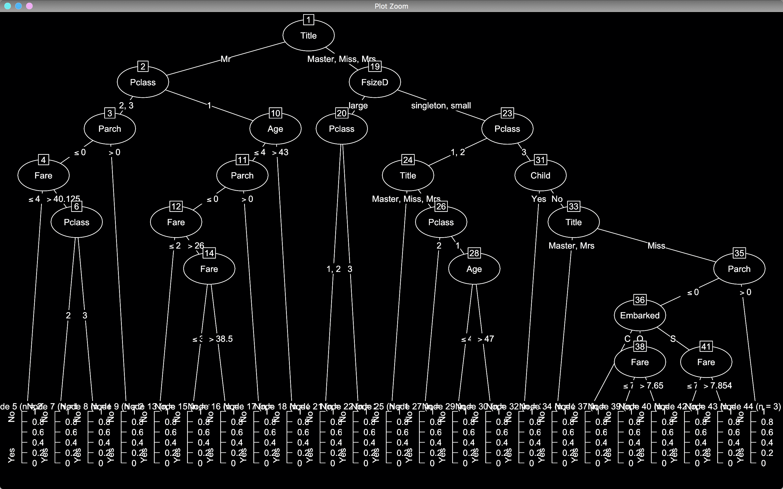
A C50 tree on the Titanic Data set
Root Node, i.e. node 1
Decision node on Pclass. If class is 1 or 2 go left, if 3 go right
Leaf node: provides classification and some statistics: support and confidence

Slide 29
Understanding Decision Trees
Decision tree learners build a model in the form of a tree structure.
The model itself comprises a series of logical decisions, similar to a flowchart
decision nodes then indicate a decision to be made on an attribute.
These split into branches indicating the decision's choices.
The tree is terminated by leaf nodes (also known as terminal nodes) that denote the result of following a combination of decisions.
Data to be classified begins at the root node where it is passed through the various decisions in the tree according to the values of its features.
The path that the data takes funnels each record into a leaf node, which assigns it a predicted class.
As the decision tree is essentially a flowchart, it is particularly appropriate for applications in which the classification mechanism needs to be transparent for legal reasons or the results need to be shared in order to facilitate decision making.

Slide 30
Uses of Decision Trees
Decision trees have wide uses.
Credit scoring models the criteria that causes an applicant to be rejected need to be well-specified
Marketing studies of customer churn or customer satisfaction that will be shared with management or advertising agencies
Diagnosis of medical conditions based on laboratory measurements, symptoms, or rate of disease progression.
They can be applied to both classification and regression problems
In practice decision trees are perhaps the single most widely used machine learning technique.
They can be applied for modeling almost any type of data—often with unparalleled performance.

Slide 31
Divide & Conquer
Decision trees are built using a heuristic called recursive partitioning.
This approach is generally known as divide and conquer because it uses the feature values to split the data into smaller and smaller subsets of similar classes.
Beginning at the root node, which represents the entire dataset, the algorithm chooses a feature that is the most predictive of the target class.
The examples are then partitioned into groups of distinct values of this feature; this decision forms the first set of tree branches.
The algorithm continues to divide-and-conquer the nodes, choosing the best candidate feature each time until a stopping criterion is reached.
This might occur at a node if:
All (or nearly all) of the examples at the node have the same class
There are no remaining features to distinguish among examples
The tree has grown to a predefined size limit.
We’ll do this more formally next week when we do a more general introduction to decision trees.

Slide 32
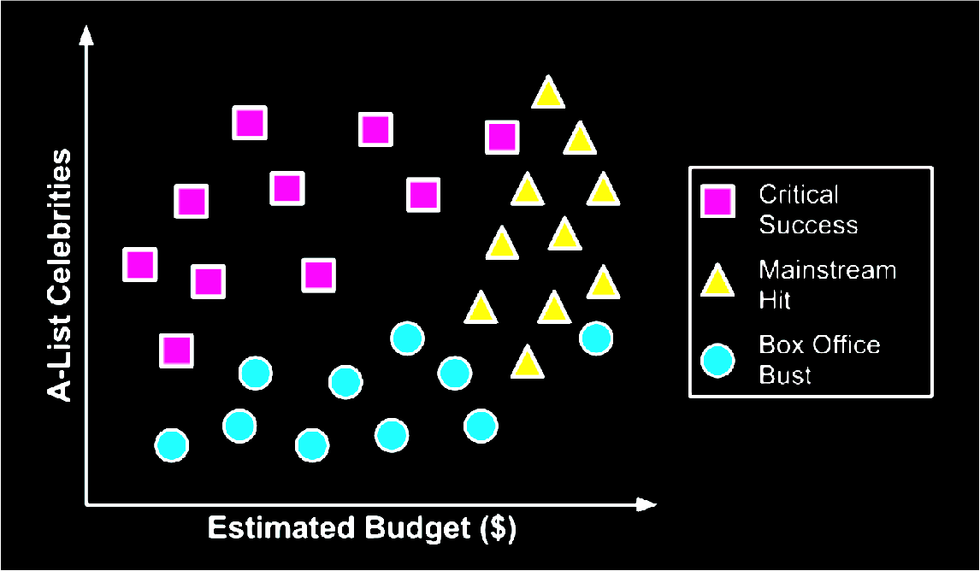
Divide & Conquer
You decide to develop a decision tree algorithm to predict whether a potential movie would fall into one of three categories: mainstream hit, critic's choice, or box office bust

Slide 33
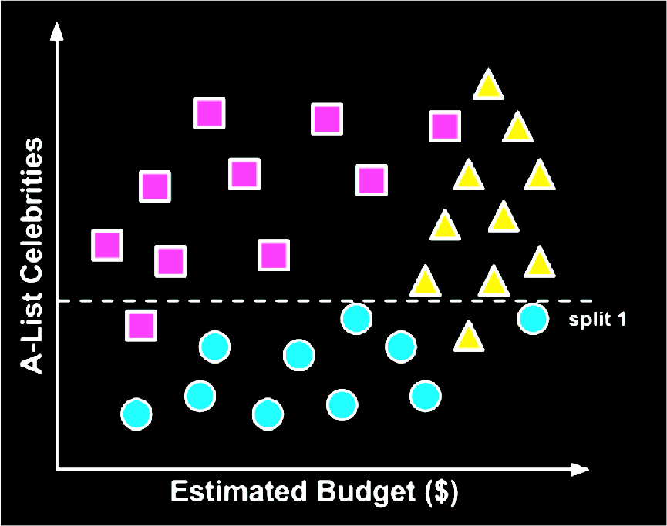
Divide & Conquer
To build a simple decision tree using this data, we can apply a divide-and-conquer strategy.
Let's first split the feature indicating the number of celebrities, partitioning the movies into groups with and without a low number of A-list stars:
Split into low number of A-list stars and high number of A-list starts.

Slide 34
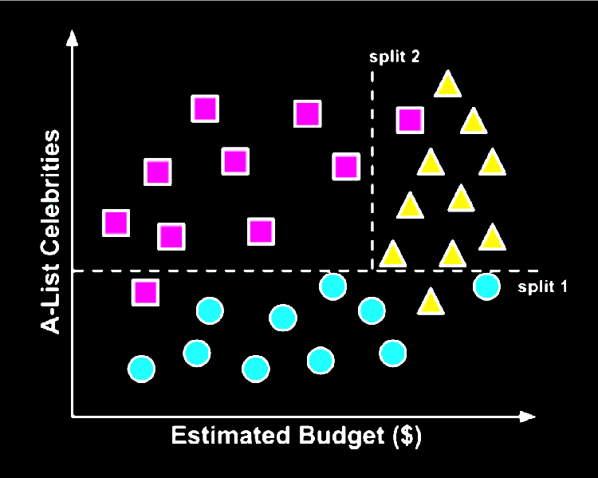
Divide & Conquer
Next, among the group of movies with a larger number of celebrities, we can make another split between movies with and without a high budget:
At this point we have partitioned the data into three groups.
The group at the top-left corner of the diagram is composed entirely of critically-acclaimed films. This group is distinguished by a high number of celebrities and a relatively low budget.
At the top-right corner, the majority of movies are box office hits, with high budgets and a large number of celebrities.
The final group, which has little star power but budgets ranging from small to large, contains the flops.

Slide 35
Divide & Conquer
If we wanted, we could continue to divide the data by splitting it based on increasingly specific ranges of budget and celebrity counts until each of the incorrectly classified values resides in its own, perhaps tiny partition.
Since the data can continue to be split until there are no distinguishing features within a partition, a decision tree can be prone to be overfitting for the training data with overly-specific decisions.
We'll avoid this by stopping the algorithm here since more than 80 percent of the examples in each group are from a single class.

Slide 36
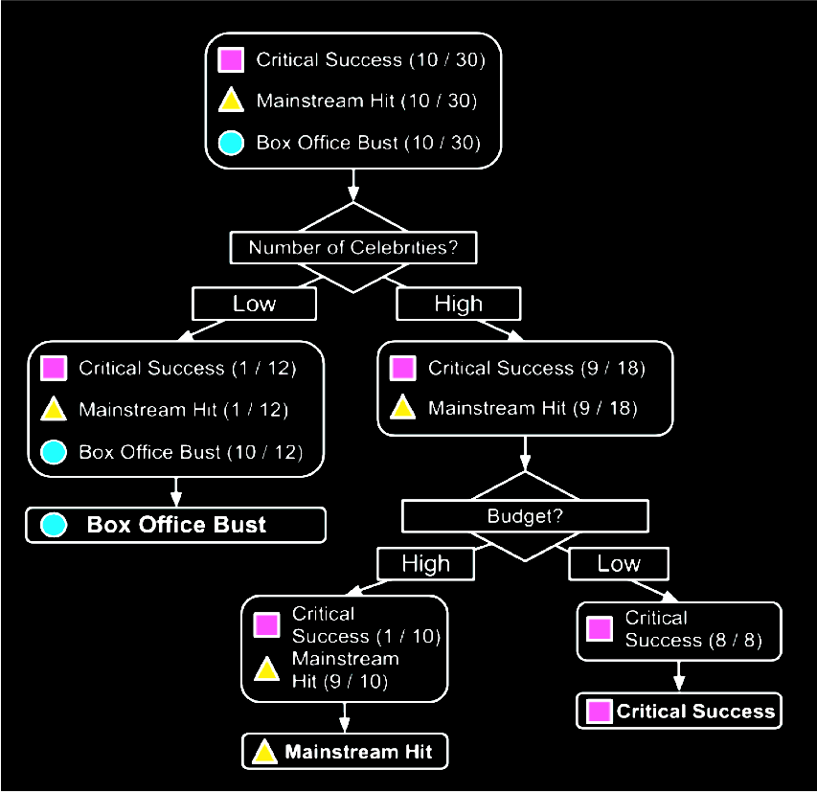
Divide & Conquer
Our model for predicting the future success of movies can be represented in a simple tree as shown.
To evaluate a script, follow the branches through each decision until its success or failure has been predicted.
Decision Nodes
Leaf Nodes

Slide 37
Divide & Conquer
Support & Confidence
Consider the following decision tree for providing a loan to a person.
The training set contains 15 examples.
The x/y values mean that x out of y training examples that reach this leaf node have the class of the leaf.
The x/y value is considered the confidence value
The x value is the support count. The support at a leaf node will be x/(total number of training examples)
Own house?
YES
Has job?
6/6
What are the support and confidence values at each of the leaf nodes??
YES
NO
3/3
6/6

Slide 38
Divide & Conquer
Note:
There may be many decision trees that can be learned from the data, and most decision tree algorithms have stochastic properties: so BUILD LOTS!!
In practice, we would like small, accurate trees
A smaller tree tends to be more general and also more accurate
Easier to understand by human users – Important in many cases
Smaller trees also generalize the data better, and are thus less susceptible to overfitting.
For most real-world datasets, the training examples that reach leaf nodes will not all have the same class.
A decision tree only finds a subset of the rules that exist in the data which is sufficient for classification.

Slide 39
Algorithms – C5.0
There are numerous implementations of decision trees, but one of the most well known is the C5.0 algorithm.
This algorithm was developed by computer scientist J. Ross Quinlan as an improved version of his prior algorithm, C4.5, which itself is an improvement over his ID3 (Iterative Dichotomiser 3) algorithm.
The C5.0 algorithm has become the industry standard for producing decision trees, because it does well for most types of problems directly out of the box.
Compared to other advanced machine learning models (such as Black Box Methods – Neural Networks and Support Vector Machines) the decision trees built by C5.0 generally perform nearly as well but are much easier to understand and deploy.
Remember we may end up having to explain our results in a compelling way!

Slide 40
C5.0 Algorithm – Where to split
The first challenge that a decision tree will face is to identify which feature to split upon. In the movie example, we looked for feature values that split the data in such a way that partitions contained examples primarily of a single class.
If the segments of data contain only a single class, they are considered pure.
There are many different measurements of purity for identifying splitting criteria.
C5.0 uses entropy for measuring purity.
The entropy of a sample of data indicates how mixed the class values are; the minimum value of 0 indicates that the sample is completely homogenous, while 1 indicates the maximum amount of disorder.
Other commonly used criteria are Gini index, Chi-Squared statistic, and gain ratio.

Slide 41
Algorithms – Pruning
A decision tree can continue to grow indefinitely, choosing splitting features and dividing into smaller and smaller partitions until each example is perfectly classified or the algorithm runs out of features to split on.
However, if the tree grows overly large, many of the decisions it makes will be overly specific and the model will have been overfitted to the training data.
The process of pruning a decision tree involves reducing its size such that it generalizes better to unseen data.
Two basic approaches:
Pre-pruning
Post-pruning

Slide 42
Algorithms – Pre-pruning
One solution to this problem is to stop the tree from growing once it reaches a certain number of decisions or if the decision nodes contain only a small number of examples.
This is called early stopping or pre-pruning the decision tree.
As the tree avoids doing needless work, this is an appealing strategy.
However, one downside is that there is no way to know whether the tree will miss subtle, but important patterns that it would have learned had it grown to a larger size.

Slide 43
Algorithms – Post-pruning
An alternative, called post-pruning involves growing a tree that is too large, then using pruning criteria based on the error rates at the nodes to reduce the size of the tree to a more appropriate level.
This is often a more effective approach than pre-pruning because it is quite difficult to determine the optimal depth of a decision tree without growing it first.
Pruning the tree later on allows the algorithm to be certain that all important data structures were discovered.
One of the benefits of the C5.0 algorithm is that it is opinionated about pruning—it takes care of many of the decisions, automatically using fairly reasonable defaults.
Its overall strategy is to post-prune the tree.

Slide 44
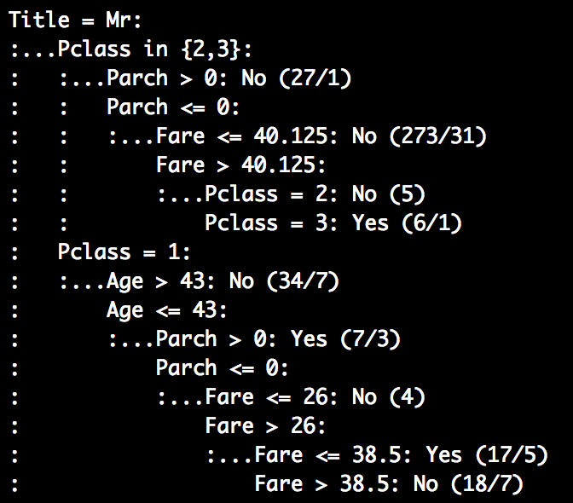
Sample output: titanic in this case
This is only part of one path from root to leaf.
The first lines could be represented in plain language as:
If the title of the passenger is Mr
If Pclass is 2 or 3, AND
If Parch > 0: predict did not survive. 27 training instances reach this node, and 1 would be incorrectly classified, i.e. they survived
If instead Parch <= 0 (0 in this case, cannot be less than 0) AND
Fare <= 40.125: predict did not survive. 273 training instances reach this node, and 31 would be incorrectly classified
…

Slide 45
Boosting the accuracy of decision trees
Train many decision trees who vote on the best class for each example.
Boosting: combining a number of weak models creates a group that is holistically strong. Each models has a unique set of strengths and weaknesses, and may be better or worse at certain problems.
Using a combination of several learners with complementary strengths and weaknesses can therefore dramatically improve the accuracy of a classifier.
The C5.0() function makes it easy to add boosting to our C5.0 decision tree: the trials parameter.
trials = n corresponds to: build n C5.0 trees.
Boosting can dramatically reduce the error compared to a single C5.0 tree.
The idea of boosting is the basic premise of ensembles: where we combine multiple classifiers into a base layer, and use another model to decide how to interpret their views (predictions) to produce the final prediction.

Slide 46
Extracting Rules
The last thing (for now) that we may wish to do with a C5.0 (as well as any decision tree) is transform the tree model into a series of rules.
For this we simply use the rules parameter; rules = TRUE.

Slide 47
C5.0 Strengths and Weaknesses
Strengths | Weaknesses
An all-purpose classifier that does well on most problems | Decision tree models are often biased toward splits on features having a large number of levels
Highly-automatic learning process can handle numeric or nominal features, missing data | It is easy to overfit or underfit the model
Uses only the most important features | Can have trouble modeling some relationships due to reliance on axis parallel splits
Can be used on data with relatively few training examples or a very large number | Small changes in training data can result in large changes to decision logic
Results in a model that can be interpreted without a mathematical background (for relatively small trees) | Large trees can be difficult to interpret and the decisions they make may seem counterintuitive
More efficient than other complex models

